Slide 1


Slide 2
AGENDA
TRADITIONAL CONFIGURATION SYSTEM
PRESENT CONFIGURATION SYSTEM
ANSIBLE
ARCHITECTURE
ANSIBLE – VALUE ADD
AGENTLESS ARCHITECTURE
PUSH & PULL CMS
USERS & OTHER CMS TOOLS
INDUSTRY ADOPTION
CASE STUDY: I-BANKING INDIA ROLLOUT
INSTALLATION & SET-UP
ANSIBLE COMPONENTS
SUPPORTIVE DOCMENTS

Slide 3
TRADITIONAL CONFIGURATION SYSTEM
Manual Intervention: Huge amount
Expected Error: Human Error
Mechanism : Shell Script / Custom Script
Communication gap: Physical and Logical
Impact: Change – Impact level
Business Impact
Reputational loss
Outcome: System Outages
Delivery: No Efficient Service Delivery

Slide 4
PRESENT CONFIGURATION SYSTEM
CURRECT CMS:
Automating entire IT Infrastructure and manage the configuration on a Automated fashion and Provisioning the same on End-to-End project management
INFRASTRUCTURE:
Server Engineering
Storage Engineering
Network Engineering
Application Engineering
Security Engineering
Database Engineering
MECHANISM:
PUSH BASED CONFIGURATION MECHANISM
PULL BASED CONFIGURATION MECHANISM
METHODOLOGY:
MASTER AND SLAVE

Slide 5
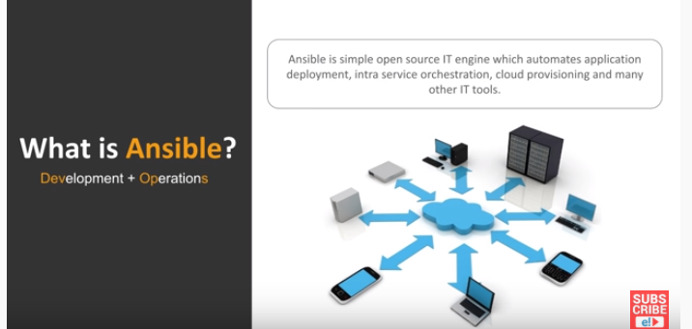
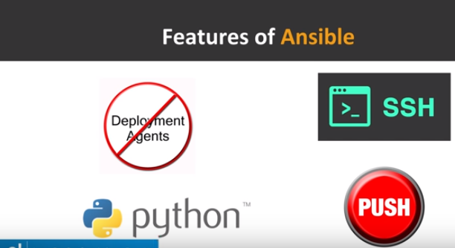
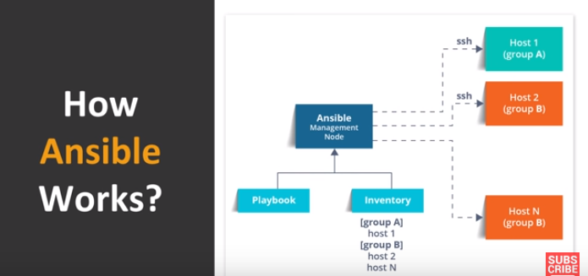

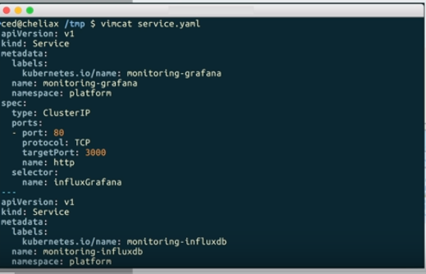
ANSIBLE
Ansible= CMS + IT Automation + Provisioning tool)
Open-source
light-weigted
Simple to learn and control
Agentless architecture
Master/Slaves architecture
SSH connectivity
yaml
Ansible uses yaml for Automation
Human readable – serialization language
Mainly uses in configuration setup
User friendly Programming language

Slide 6
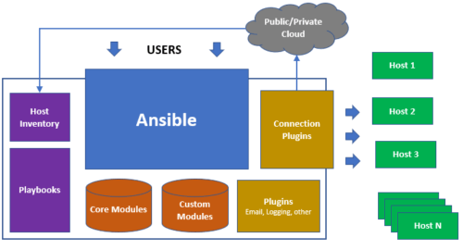
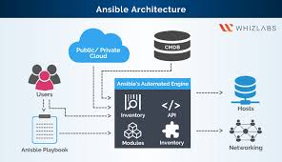

ARCHITECTURE
Host inventories - Ansible uses a combination of a hosts file and a group vars directory to pull variables per host group and run Ansible plays/tasks against hosts.
An Ansible playbook is an organized unit of scripts that defines work for a server configuration managed by the automation tool Ansible. configuration management tool that automates configuration of multiple servers by the use of Ansible playbooks.
Ansible modules are reusable, standalone scripts that can be used by the Ansible API, or by the ansible or ansible-playbook programs.
PlungIns are uses to establish connection, Daemon process, Runs in backend, No end user interaction
Email, Logging and Connection PlugIns are few we use.

Slide 7
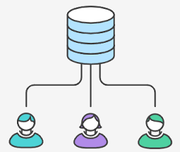
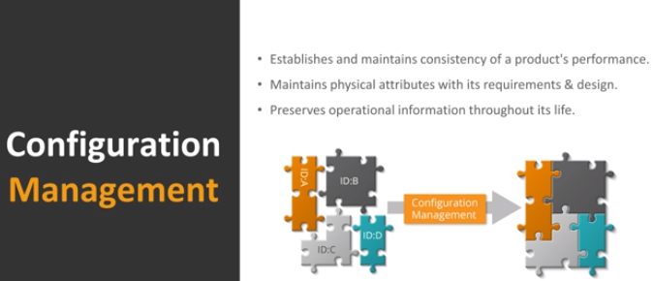
ANSIBLE – VALUE ADD
AGENTLESS
env LOOKUP PLUGINS
HOST INVENTORY
ANSIBLE -GALAXY
ANSIBLE-TOWER
ANSIBLE-AWX
ANSIBLE-REDHAT
CONTROL -NODE
IDEMPOTENCY
ANSIBLE-VAULT
ANSIBLE COWSAY
ANSIBLE MODULES
YAML

Slide 8
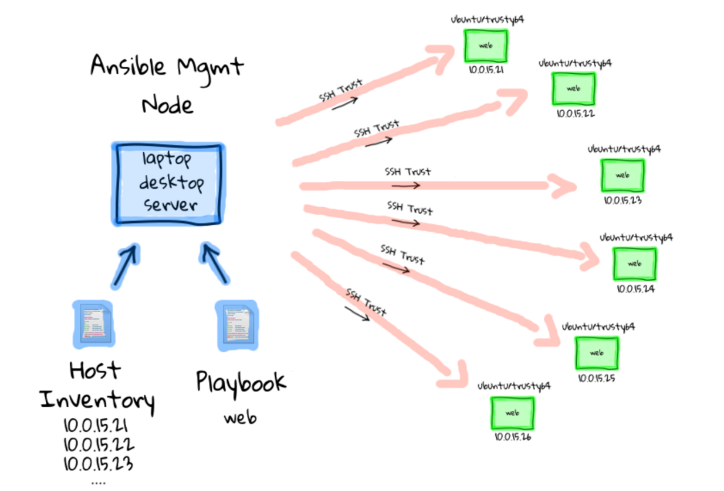
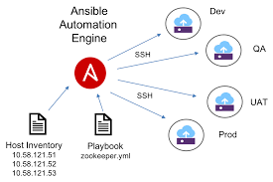
AGENTLESS ARCHITECTURE

Slide 9
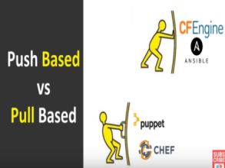
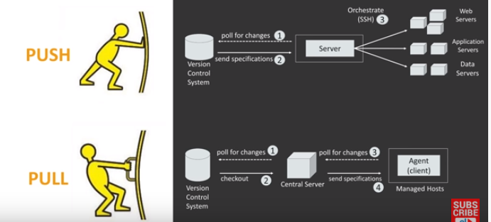
PUSH & PULL CMS
ANSIBLE – PUSH
SALT STACK – PUSH & PULL
CHEF & PUPPET - PULL
ANSIBLE (PUSH) | CHEF or PUPPET (PULL)
Master has centralized control over nodes | Can do 100% Automation
Easy to learn and implement | Dynamic Scaling is possible
Can Automate upto certain level not 100% | Need Agent wise manual setup is required initially and it cost time and effort
There is no Scaling facility available

Slide 10

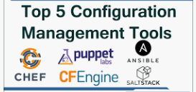
USERS & OTHER CMS TOOLS

Slide 11
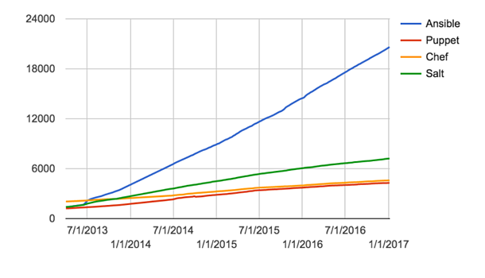
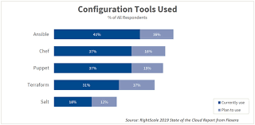
INDUSTRY ADOPTION

Slide 12
CASE STUDY: I-BANKING INDIA ROLLOUT
PROBLEM STATEMENT:
Application: ONLINE BANKINK; Country: INDIA; Module: TRANSACTION
Local System: We were able to implement the build and Test in developers Local system successfully using openjdk-8-jdk
Test Environment: Through Service-delivery while we implement same into UAT environment the implementation got failed due version mismatch because the test environment contains
openjdk-11-jdk
Impact: Which resulted delay in UAT, and leads software delivery slowness
SOLUTION:
We have launched Ansible configuration management tool to auto updating of the configurations and make sure no failure in deployment due to environment dependencies
Automation: Automated end-to-end project phases configuration using Ansible.
CONCLUSION: ce this scenario falls in Testing Environment, consider if it happens in
Production Environment causes of the impact is huge

Slide 13

INSTALLATION & SET-UP
ANSIBLE INSTALLATION & SET-UP

Slide 14
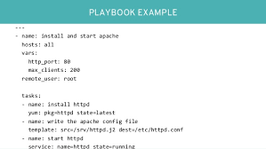
ANSBILE COMPONENTS
ANSIBLE AD-HOC COMMANDS
Execute single Task to multiple Nodes through modules
ANSIBLE PLAYBOOK
EXECUTE MULTIPLE TASK AS A PLAYBOOK USING YAML
ANSIBLE-ROLES
DIRECTORY STRUCTURE OF ANSIBLE MODULES
ANSIBLE-VAULT
ENCRYPT CONFIDENTIAL YAML

Slide 15
SUPPORTIVE DOCUMENTS
ANSIBLE SELF DOCUMENT END TO END
ANSIBLE AND JENKINS INTEGRATION THROUGH SSH
ANSIBLE INTERVIEW QUESTIONS AND ANSWERS

Slide 16
THANK YOU

